Slide 1

Supervised Learning Algorithms
Agenda
Introduction to KNN
K-Nearest Neighbors intuition
Advantages & Disadvantages
Applications

Slide 2
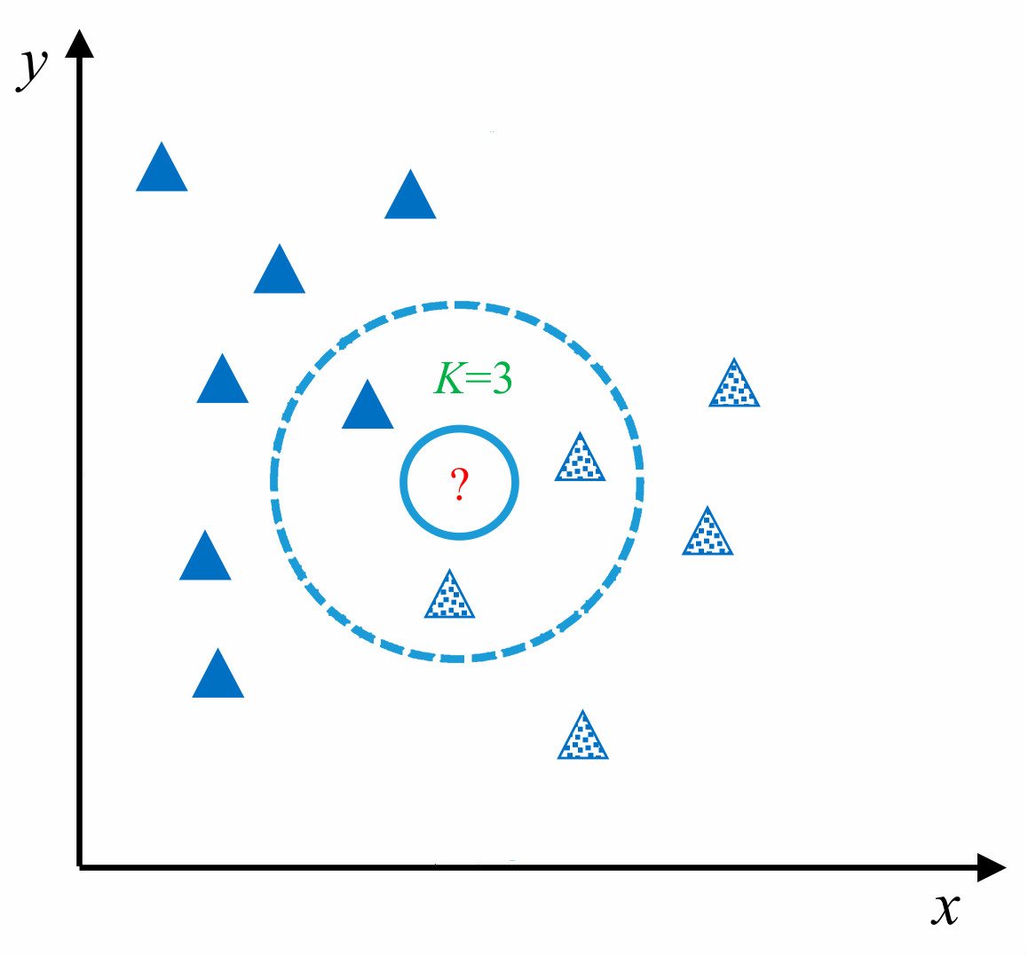
K-Nearest Neighbors (KNN) Algorithm
Definition: KNN is a supervised learning algorithm used for both classification and regression.
Lazy learning: No explicit training phase, makes predictions by comparing new data points to stored instances.
Instance-based: Relies on the similarity of data points.

Slide 3
Working Principle of KNN
Step 1: Choose the number of neighbors K.
Step 2: Measure the distance between the new data point and all existing points.
Step 3: Identify the K nearest neighbors.
Step 4: Assign a class (for classification) or compute the average (for regression).

Slide 4
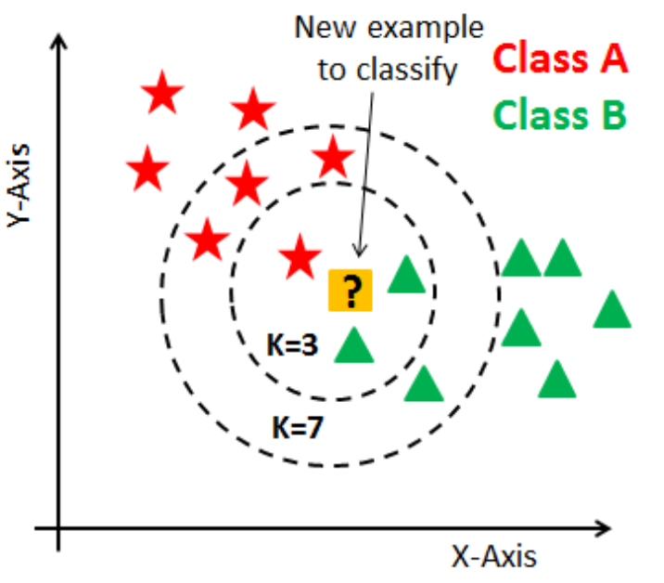
Choosing the Value of K
Small K (e.g., 1, 3, 5): ✔ More sensitive to noise ✔ Higher variance
Large K (e.g., 10, 15, 20): ✔ Smoother decision boundary ✔ Reduces overfitting but may lose important details
Rule of thumb: Use √N (square root of the dataset size) as a starting point.

Slide 5
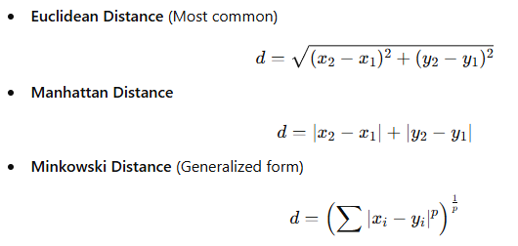
Distance Metrics in KNN
To find the nearest neighbors, KNN uses different distance measures:

Slide 6
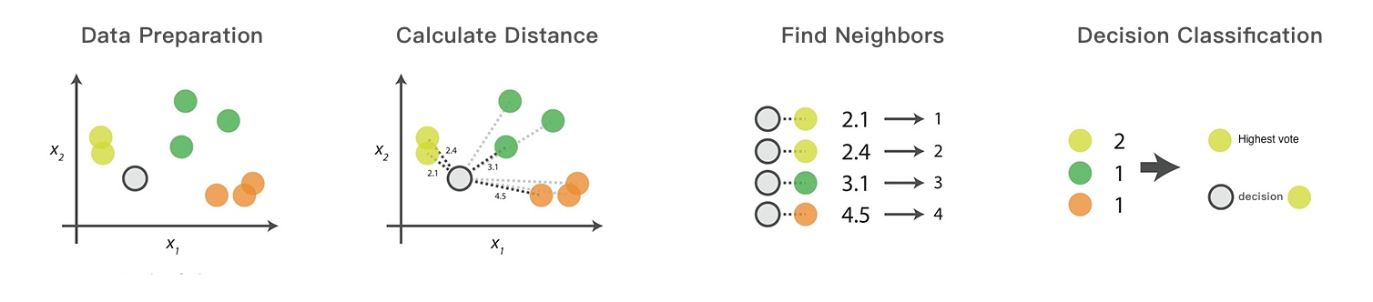
Distance Metrics in KNN

Slide 7
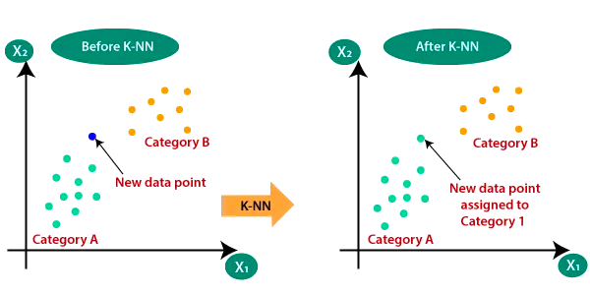
KNN for Classification
The majority class among the K nearest neighbors determines the new data point’s class.
Example:
Given a dataset of apples and oranges, predict whether a new fruit is an apple or an orange.
Count the nearest K neighbors and assign the majority class.

Slide 8
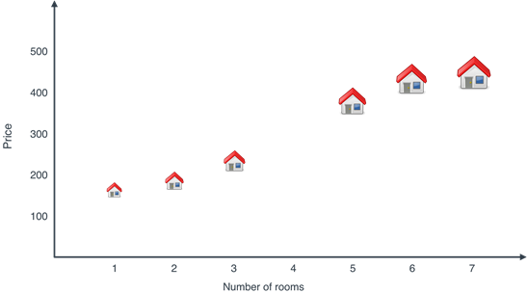
KNN for Regression
Instead of voting, KNN regression predicts the output by averaging the values of K nearest neighbors.
Example:
Predicting house prices based on similar houses in the neighborhood.

Slide 9
Advantages and Disadvantages of KNN
Advantages
✔ Simple and Easy to Implement – No complex model training required. ✔ Non-Parametric – No assumptions about data distribution. ✔ Handles Multi-Class Classification Well – Works well for multiple categories. ✔ Can Be Used for Both Classification and Regression.
Limitations of KNN ⚠ Computationally Expensive – As the dataset grows, the prediction speed slows down. ⚠ Sensitive to Noise and Outliers – A few irrelevant points can mislead predictions. ⚠ Curse of Dimensionality – KNN works poorly when the number of features is too high. ⚠ Storage Intensive – Needs to store the entire dataset for predictions.

Slide 10
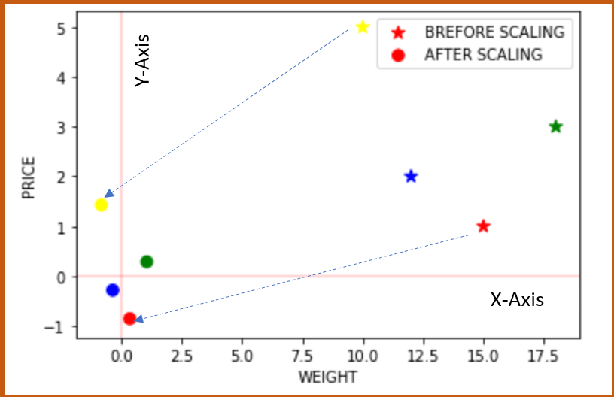
Improving KNN Performance
✅ Feature Scaling (Normalization/Standardization) – Standardize data to prevent large-scale differences. ✅ Dimensionality Reduction (PCA, LDA) – Reduce the number of features. ✅ Efficient Data Structures (KD-Tree, Ball-Tree) – Speed up nearest neighbor search. ✅ Weighted KNN – Give closer neighbors higher importance in decision-making.

Slide 11
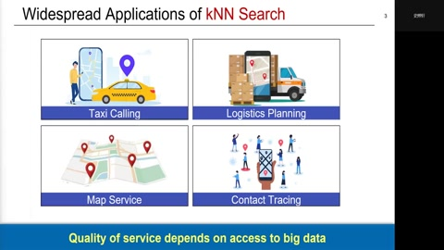
Applications of KNN

Slide 12
KNN vs. Other Algorithms
Feature | KNN | Decision Tree | SVM | Neural Networks
Speed | Slow (High data) | Fast | Moderate | Slow
Interpretability | Easy | Easy | Hard | Very Hard
Works on Small Data? | Yes | Yes | Needs tuning | Needs lots of data
Sensitive to Outliers? | Yes | No | Yes | Yes
⚠ Avoid KNN if:
You have large datasets (it’s slow).
There are too many features (curse of dimensionality).

Slide 13
Thank You

